Slide 1
What’s so funny ‘bout peace, love and understanding?
Steve Brown
(University of the West of Scotland)
IATEFL GISIG/TDSIG Pre-Conference Event 2019
steve.brown@uws.ac.uk @sbrowntweets stevebrown70.wordpress.com

Slide 2
Definition and connotations
The importance of social justice
Social justice in education
The ELT context
Conclusions

Slide 3
“Social Justice Warrior”
Dictionary Definitions:
‘A person who promotes socially progressive views.’ *
(Oxford Living Dictionaries Online)
‘A person who campaigns zealously and vociferously for causes associated with social justice.’ *
(Collins English Dictionary)
*’derogatory’

Slide 4
“Social Justice Warrior”
If you google it…
‘…a pejorative term for an individual who promotes socially progressive views, including feminism, civil rights and multiculturalism, as well as identity politics. The accusation that somebody is an SJW carries implications that they are pursuing personal validation rather than any deep-seated conviction, and engaging in disingenuous arguments. ’
(Wikipedia)

Slide 5
“Social Justice Warrior”
If you google it…
‘A person who uses the fight for civil rights as an excuse to be rude, condescending and sometimes violent for the purpose of relieving their frustrations or validating their sense of unwarranted moral superiority.’
(Urban Dictionary)

Slide 6
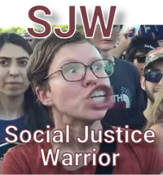
+
=
Image Source: https://www.eastbayexpress.com/oakland/eleventh-annual-social-justice-symposium-healing-through-resistance/Content?oid=5091299
Image Source: https://wall.alphacoders.com/big.php?i=377832
Image Source: https://leeduigon.com/tag/how-to-turn-your-brain-into-mush/

Slide 7
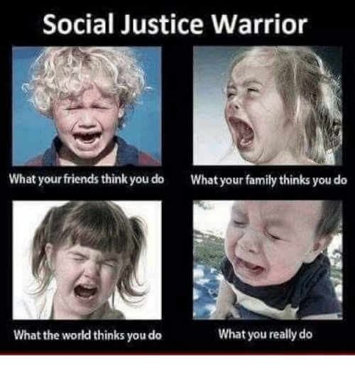
Image Source: https://www.abc.net.au/news/2017-03-31/social-justice-warrior-meme.jpg/8400244 /

Slide 8
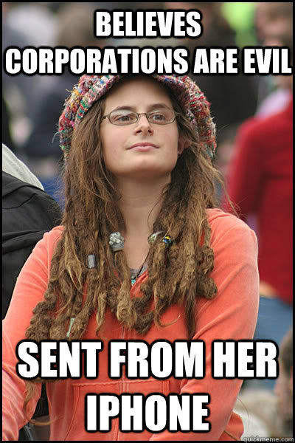
SJWs are…
Extremists
Self-righteous
Self-serving
Violent
Insincere
Hypocrites
Crybabies
Overly judgemental
Ridiculous
Image Source: https://dailycaller.com/2018/04/26/keyboard-warriors-starbucks-boycotts-and-virtue-signaling-for-fun-and-profit/ /

Slide 9
What is social justice really?
‘Notions of social justice generally embrace values such as the equal worth of all citizens, their equal right to meet their basic needs, the need to spread opportunity and life chances as widely as possible, and finally, the requirement that we reduce and, where possible, eliminate unjustified inequalities.’
(Finn and Jacobsen 2017)

Slide 10
What is social justice really?
‘Notions of social justice generally embrace values such as the equal worth of all citizens, their equal right to meet their basic needs, the need to spread opportunity and life chances as widely as possible, and finally, the requirement that we reduce and, where possible, eliminate unjustified inequalities.’
(Finn and Jacobsen 2017)

Slide 11
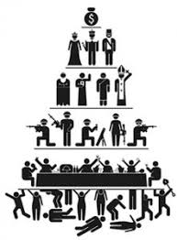
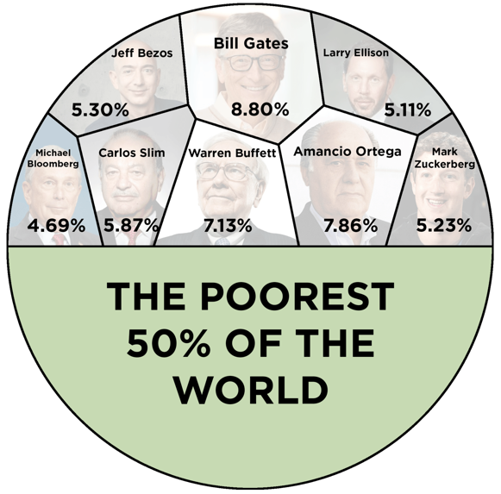
How global society is currently structured
Notes:
Hierarchical
Unequal
Hegemonic

Slide 12
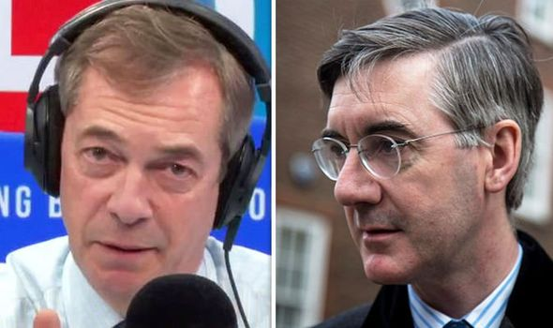
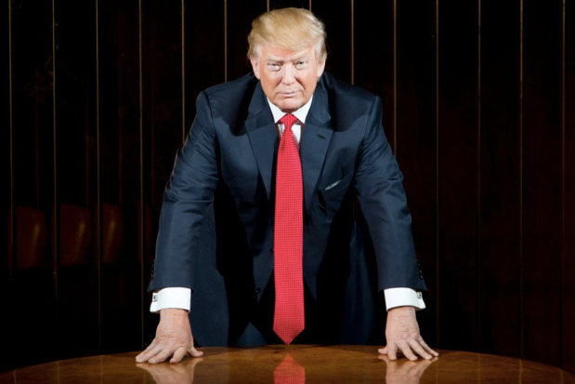
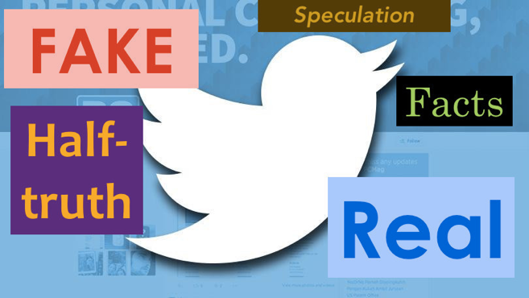
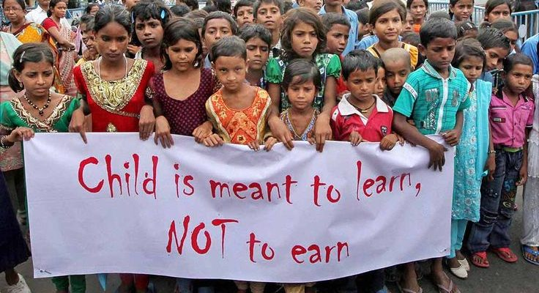
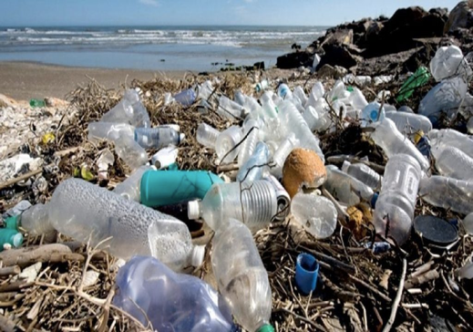
Impact of current social structures
Notes:
Hegemony means a society that serves the interests of the powerful is presented as best for everyone. So people are led to believe that someone who seeks to further empower the powerful is also going to represent their interests (Trump).
Political decisions are presented as serving the interests of the powerless, but it’s actually the powerful who will really benefit. (Rees-Mogg and Farage).
Social media is being maximised to spread a wide range of discourses, to such an extent that it’s hard to distinguish between fact and reality, fake news and satire, so we don’t really know what’s going on (fake news).
Social media also used to divide society by creating echo chambers so we only ever see stories we already agree with. (divided society)
This makes it easier for oppressive regimes to make agreements with each other that will benefit huge successful corporations (e.g. weapons manufacturing companies) and which will at the same time be seriously damaging for the vulnerable (Trump signing arms deal).
Ultimately, the interests of the vulnerable are ignored, and the interests of the powerful few drive everything, including reasons for going to war (something about oil and Iraq)…
…promotion of a consumer society and the waste it produces…
…climate change denial (photos of deforestation, fossil fuel companies,)…
…or use of children as cheap labour, which of course also denies them access to education so they can’t learn how much they’re being exploited.

Slide 13
If you don’t believe in social justice…
…you must be OK with…
injustice
inequality
oppression
hegemony
…embedded within social structures.
Image Source: http://everydayfeminism.com/wp-content/uploads/2015/05/Screen-Shot-2015-05-11-at-3.06.41-PM.png

Slide 14
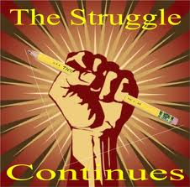
What is the purpose of education?
To emancipate?
To empower?
To indoctrinate?
Notes:
Establish that the only way for education to be properly transformative in a societal sense is to take an emancipatory approach.

Slide 15
Education for Social Justice
‘…the creation of an informed, critical citizenry capable of participating and governing in a democratic society.’
(Giroux 2011: 7)

Slide 16
Education for the Status Quo
Image Source: https://www.mygoldmusic.co.uk/hall-of-fame/hall-of-fame-status-quo/status-quo-12/

Slide 17
Education for the Status Quo
Vulnerable people excluded from education (disempowerment)
2-tier education systems (inequality)
Focus on meeting corporate employer needs rather than societal needs (hegemony)
Promotion of dominant sociocultural and economic values (indoctrination)
Education conceptualised as an economic investment (human capital theory)

Slide 18
But ELT isn’t like this…is it?
Vulnerable people excluded from education (disempowerment)
2-tier education systems (inequality)
Focus on meeting corporate employer needs rather than societal needs (hegemony)
Promotion of dominant sociocultural and economic values (indoctrination)
Education conceptualised as an economic investment (human capital theory)

Slide 19
But ELT isn’t like this…is it?
Minorities under-represented in ELT materials (disempowerment)
2-tier education systems (inequality)
Focus on meeting corporate employer needs rather than societal needs (hegemony)
Promotion of dominant sociocultural and economic values (indoctrination)
Education conceptualised as an economic investment (human capital theory)

Slide 20
But ELT isn’t like this…is it?
Minorities under-represented in ELT materials (disempowerment)
Huge elitist private sector (inequality)
Focus on meeting corporate employer needs rather than societal needs (hegemony)
Promotion of dominant sociocultural and economic values (indoctrination)
Education conceptualised as an economic (human capital theory)

Slide 21
But ELT isn’t like this…is it?
Minorities under-represented in ELT materials (disempowerment)
Huge elitist private sector (inequality)
Lack of critical engagement with dominant, neoliberal ideology (hegemony)
Promotion of dominant sociocultural and economic values . (indoctrination)
Education conceptualised as an economic investment (human capital theory)

Slide 22
But ELT isn’t like this…is it?
Minorities under-represented in ELT materials (disempowerment)
Huge elitist private sector (inequality)
Lack of critical engagement with dominant, neoliberal ideology (hegemony)
Aspirations include materialism, NS superiority, heteronormativity etc. (indoctrination)
Education conceptualised as an economic investment (human capital theory)

Slide 23
But ELT isn’t like this…is it?
Minorities under-represented in ELT materials (disempowerment)
Huge elitist private sector (inequality)
Lack of critical engagement with dominant, neoliberal ideology (hegemony)
Aspirations include materialism, NS superiority, heteronormativity etc. (indoctrination)
English presented as a key to economic success, both for individuals and nations (human capital theory)

Slide 24
How did we allow this to happen?
The Myth of Neutrality
‘Washing one’s hands of the conflict between the powerful and the powerless means to side with the powerful, not to be neutral.’
(Freire 1996: 122)

Slide 25
Summary
A fundamental purpose of education is (or should be) to give people the skills to make the world a better place.
Therefore, social justice is (or should be) a key feature of our praxis as educators.
A far more extremist and damaging view is that education should NOT include the promotion of social justice.

Slide 26
Image Source: https://leeduigon.com/tag/how-to-turn-your-brain-into-mush/
Notes:
Return to this image to show that social justice warriors are presented as these mad, radical, slightly unhinged, extremists. But actually, there’s absolutely nothing remotely radical or extreme about taking an approach to education that promotes social justice.

Slide 27
Anti-Death Warrior?
Image Source: https://www.rd.com/health/wellness/tips-choosing-primary-care-doctor/

Slide 28
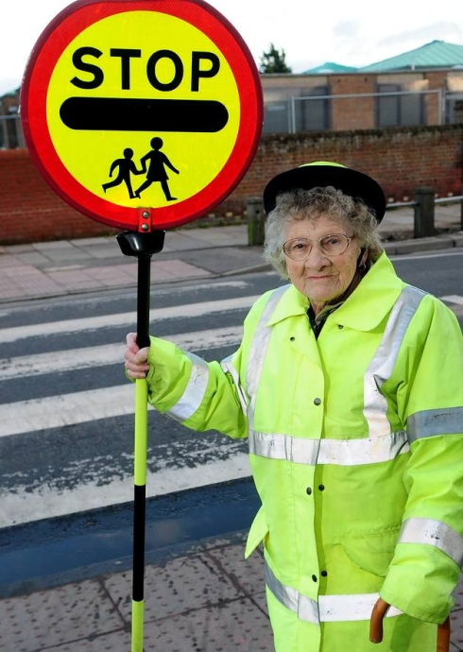
Road Safety Warrior?
Image Source: https://www.greatyarmouthmercury.co.uk/news/families-bid-farewell-to-yarmouth-lollipop-lady-1-1328082

Slide 29
Literacy Warrior?
Image Source: https://www.vox.com/culture/2018/8/11/17674528/librarian-women-too-dangerous

Slide 30
Conclusion
There’s nothing radical or extremist about attempting to use education to develop a more equitable society.
However, the current ELT paradigm actively promotes inequality, injustice, indoctrination and hegemony.
Teachers who promote social justice are not warriors – they’re teachers.

Slide 31
References
Education Scotland (2019), The Purpose of the Curriculum, availabl;e from: https://education.gov.scot/scottish-education-system/policy-for-scottish-education/policy-drivers/cfe-(building-from-the-statement-appendix-incl-btc1-5)/The%20purpose%20of%20the%20curriculum [accessed 23 March 2019].
Freire, P. (1996), Pedagogy of the Oppressed, London: Penguin.
Finn, J. and Jacobsen, M. (2017), ‘What is Social Justice?’, OUP Blog, available from: https://blog.oup.com/2017/03/what-is-social-justice/ [accessed 23 March 2019].
Gibb, N. (2015), https://www.gov.uk/government/speeches/the-purpose-of-education
Giroux, H. (2011), On Critical Pedagogy, London: Bloomsbury.

