Slide 1
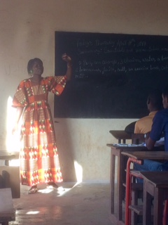
Materials for change: simple research anyone can do to help both teachers and students
AfricaTESOL PCE, Abuja
Linda Ruas (and Ali Djau – ELTA Guinea Bissau)

Slide 2
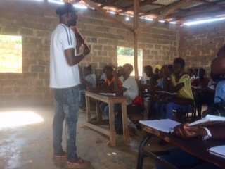
This workshop:
Warmer
Types of research
Problem / question
Research
Results
What we can do

Slide 3
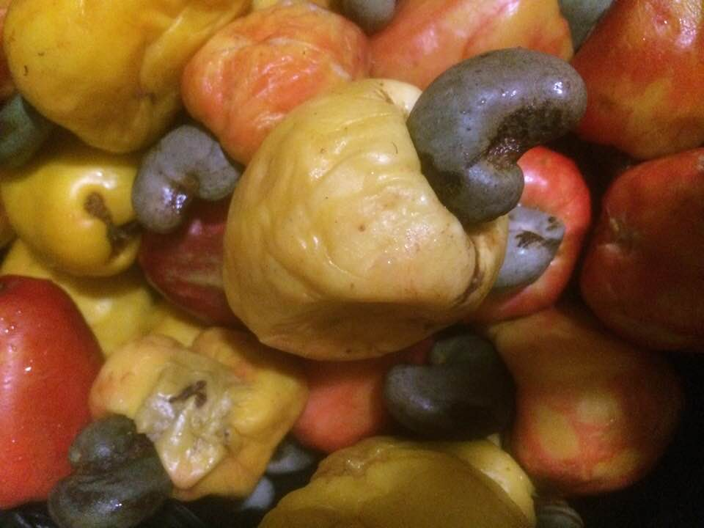
Which is most interesting? And why?:
Inspirational Bissau Guinean women
Cashew nut harvest
The new ‘Black Culture’ museum in Dakar
Protecting us from diseases
Organic food
6. Safe sex for teenagers
7. Parents sharing childcare
8. Women in the fields
9. The Voodoo Festival, Benin
10. FGM
11. Girls and boys are equal
12. Renewable energy

Slide 4
1/ Are global and social issues on the secondary English curriculum? 2/ Do teachers and students think they should be?
Interface between ELT Policies and Practice: A Global Perspective
Editors: Eric Ekembe, Lauren Harvey, Eric Dwyer Publisher: Palgrave Macmillan
Policy on global issues in Sub Saharan Africa: a possible role for ELT from examples in Guinea Bissau, Senegal and DRC by Linda Ruas and Ali Djau
How would you find out?

Slide 5
Which type of research?
Questioning and recording answers
Background context study
Qualitative research
Quantitative research
Action research
Descriptive research
1/ Guinea Bissau, Senegal and DRC and relevance of global and social issues
2/ Look at the curricula and extract references to global / social issues
3/ Ask teachers and students if they think these issues should be included in English classes

Slide 6
Research and the power to investigate and change:
Motivates teachers
Improves teaching
Solves problems
Builds stronger communities of teachers
Makes teachers feel more powerful

Slide 7
Steps:
Think – decide on a problem you’d like to find out more about
Discover – change what you do / change what the students do / experiment / try out something new / ask / discuss
Analyse – look at what happened / what people said or did to see what conclusions you can draw
Write – to summarise what you found out
Share – so others can learn what you learnt

Slide 8
Example 1
Think:
‘Can my students work faster?’
discover
analyse
write
share

Slide 9
Example 1:
a) Note the time the students took and the number of students who wrote the number of sentences you asked for – did it work?
b) Can students work faster?
c) Lots of other teaches read it, learn from it, and try it out
d) Write 3 simple sentences about what the problem was, what you did, and what you learnt and send to Linda for the next Joint GISIG – ELTA-GB newsletter
e) Plan to increase the number of sentences you tell students to write in a certain time over 3 lessons eg. 2 sentences in 10 minutes >> 4 sentences in 10 minutes >> 6 sentences in 10 minutes
Think
Discover
Analyse
Write
Share

Slide 10
Example 2:
Think:
‘Will my students learn more if I translate?’
discover
analyse
write
share

Slide 11
Example 2:
a) Write 3 simple sentences about the problem, what you did, and what you learnt, and post this in the ELTA-GB WhatsApp group
b) Teach 2 different vocabulary lessons : i/ all in English ii/ all words translated (Pt). Tell students you’ll give them a test the next week on all the words. Give them a quick test on the same number of words from each lesson eg. labelling 2 simple diagrams.
c) Lots of other teachers read it, learn from it, and try it out
d) Compare results and count how many words from each lesson students got correct. Is there a difference?
2. Discover
3. Analyse
4. Write
5. Share

Slide 12
Context: Guinea Bissau Secondary school English
Observation visit, October 2018:
lovely teachers making the most of very few resources and keen to learn
very traditional teaching consisting mainly of copying and reading aloud
very teacher-centred classes and little student engagement
mostly decontextualized, unreal content eg. from US websites
Solution?: GLOBAL, SOCIAL AND LOCAL ISSUES

Slide 13
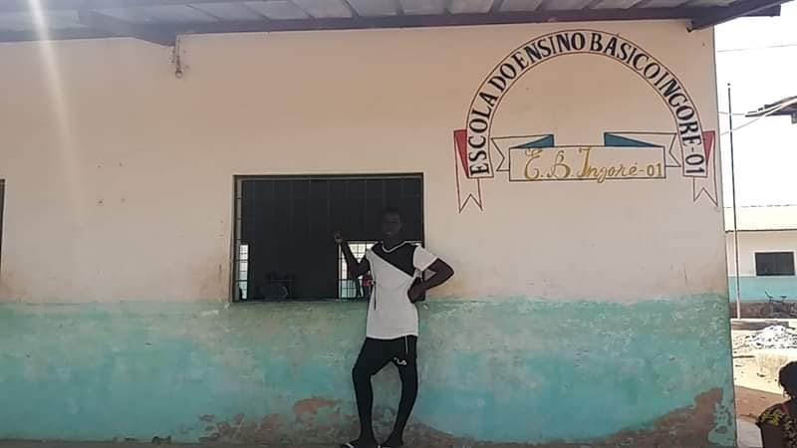
Research involving global issues
a) With teachers – to motivate, engage and develop
b) With students – to motivate, engage, educate and mobilise
Key: involve them in something REAL, LOCAL, IMPORTANT
What would you do? And how?

Slide 14
2 different pieces of research:
1/ Small-scale simple classroom research about students:
‘Does bringing global / local / social issues into English classes increase motivation to learn English and/or to get involved in the global / local / social issues?’
2/ Slightly more complex research about teachers:
‘Can involving teachers in creating materials based on global / local / social issues be a motivating way of moving them on from very traditional teacher-centred copying and reading aloud to more communicative learning activities?’

Slide 15
Ali Djau – research with students - what I did:
Stage 1: January with2 different English groups do a simple survey about how interested they are in learning English and various global / social / local issues. You say a topic and they hold up the number of fingers (0 – 5, 5 = very interested, 0 = not interested at all) that represent their level of interest:
Music, English lessons, Politics, The environment, Social problems in Guinea Bissau, Health, Food, World problems
Stage 2: February to June use all the ELTA-GB ESA lesson plans for raising awareness about the many global / social / local issues and also for involving students more actively in English lesson in ESA lessons

Slide 16
Stage 3: July Repeat the 5 – 10 minute survey from January, counting up the total number of fingers for each topic to see if numbers 2, 3, 4, 5, 6 and 8 have increased. (‘Music’ and ‘food’ have been included as topics that most of them will already be motivated about).
Results: - if number 2 has increased, this shows that bringing materials about global and social issues into English class increases motivation in learning English
if 3, 4, 5, 6, 8 have increased, this shows that bringing materials about global and social issues into English class increases interest in these issues
What do you think the results were?

Slide 17
Linda Ruas – research with teachers - what I did:
Stage 1: May – October 2018 – WhatsApp group discussions
Stage 2: Oct/Nov 2018 – GB visit 1 to observe teachers and deliver workshops
Stage 3: Jan – April 2019 - develop simple ESA materials based on short reading texts on global / social / local issues (+ WhatsApp group support / discussions)
Stage 4: April 2019 – GB visit 2 to observe teachers, deliver workshops and give laminated materials to use + new curriculum / handbook

Slide 18
Stage 5: May – July 2019 – teachers try out materials (+ WhatsApp group support / discussions)
Stage 6: July 2019 – GB visit 3 to observe teachers to see difference – + National Convention – feedback from teachers on using materials
Stage 7: October / November 2019: GB visit 4 – observation of same teachers as last year to see difference
What do you think the results were?

Slide 19
Results ….

Slide 20
So … can global issues motivate both students and teachers and help teachers develop?
How? Why? – groups of 3 or 4 discuss

Slide 21
Lesson 5: Transport in Guinea Bissau
What’s the best way to get from Bissau to Bafata? We could go by helicopter, but that would be very expensive. Or we could fly in a small plane, but that would be expensive too.
We could walk, but that would take weeks! We could go by train, but we don’t have any trains here.
We could cycle if we had bikes, but it’s too hot to cycle a long distance. We could swim up the river, but that might be dangerous. Or we could go by canoe if the canoe could get along all parts of the river.
Maybe we could take a taxi, but that might be expensive. Or we could ask a toca-toca driver to take us there, but he’d probably say no.
The best way is probably to get a bus. It will only take 3 or 4 hours, and it will be comfortable and not too expensive.
5/ ‘Transport’– 40 mins
Objectives: | For learners to develop reading skills of skimming and reading for detail For learners to learn vocabulary of types of transport with related prepositions For learners to see and understand conditional sentences and use linkers ‘but’ and ‘because’
1/ E - Engage
5 mins | Play a game where one student comes to the board and draws a type of transport in 5 seconds and the others have to name it. The student who names it is the next one to come to the board and draw. Get students to repeat the names of the types of transport several times.
2/ S - Study
mins 5 mins 10 mins | a)Prediction: Ask students: What’s the best way to get from Bissau to Bafata? They tell their partner what they think. Check prepositions: by bus/train/ bike/ helicopter/ plane/canoe; and on foot / walking / swimming b)Skim reading: students have 2 minutes to skim to find the best way. See if they agree with the text. c)Read for detail / language focus: Ask students a few questions: Why not by plane? Because it’s too expensive Why not by bike? Because it’s too hot Why not by canoe? Because it’s too difficult Guide students to see the pattern, then get them, in pairs, to write 4 more questions, and ask each other.
TEXT
3/ A - Activate
10 mins | Put students in groups of 3 and get them to discuss and decide how to order the types of transport, for: comfort d) speed expense e) personal preference c) sustainability

Slide 22
Lesson 10: FGM 'Huge and significant decline' in FGM across most of Africa, report says (CNN) November 7, 2018
The rate of female genital mutilation, or cutting, in young girls has seen a "huge and significant decline" across most parts of Africa over nearly three decades, according to a new analysis.
The fastest drop has been in East Africa, says the report, published Wednesday in the British Medical Journal. There, prevalence among girls up to 14 years old dropped from 71.4% in 1995 to 8% in 2016.
Traditionally, rates have been high in East African nations, such as Somalia, where 98% of women between the ages of 15 and 49 have been cut, according to UN figures.
The decline has been "much slower" in West and North Africa but is still significant, said the report's authors, a team of UK and South African researchers led by Ngianga-Bakwin Kandala, professor of biostatistics at Britain's Northumbria University.
In North Africa, the percentage of girls undergoing FGM dropped from 57.7% to 14.1% between 1990 and 2015, according to the report. Meanwhile, in West Africa, the prevalence of the practice fell from 73.6% in 1996 to 25.4% in 2017.
Engage Personalisation Opinions - good or bad?
Study Vocabulary Scan task (numbers) Reading comprehension
Activate Discussion Poster Radio bulletin

Slide 23
Task: create some simple lesson plans to a) motivate teachers and students and b) help develop interactive learning
1/ decide on a global / local / social / African issue you’d like to create a lesson about
2/ write / find a short text
3/ decide on the objectives of the lesson:
Skills objectives: which reading skill(s) do you want to develop?
Language objectives: vocabulary? / grammatical structure? / function?
Awareness-raising objective: what is the important topic to discuss?

Slide 24
Task (continued):
4/ Decide on a lesson length: eg. 40 mins? And the level of the class
5/ Plan an ESA lesson:
E – engage – a 5–15-min pair/group task that leads into the topic and lesson, involves all learners, is at the right level of ability
S – study – 1 – 4 tasks, preferably pair / group eg. vocabulary pre-teach, text prediction, skim and/or scan tasks, detailed reading tasks, focus on target language
A – activate – 1 or 2 pair or group tasks to get students to think about and discuss the issue in question

Slide 25
Research you can do now:
1. With students or with teachers?
2. About one specific global / social issue or many global / social issues?
3. How much time do you have?
4. What’s the problem / question you’re working on?
5. What’s your plan?
6. Results? Write? Share?

Slide 26
Follow-up support:
ELTA-GB website:
https://eltagb1.wixsite.com/elta-gb/resources-and-links
lindaruas@hotmail.com
ResearchSIG webinars

