Slide 1
From the ground up…
Integrating criticality
into initial teacher training
Rose Aylett
www.pop-uptrainer.com

Slide 3
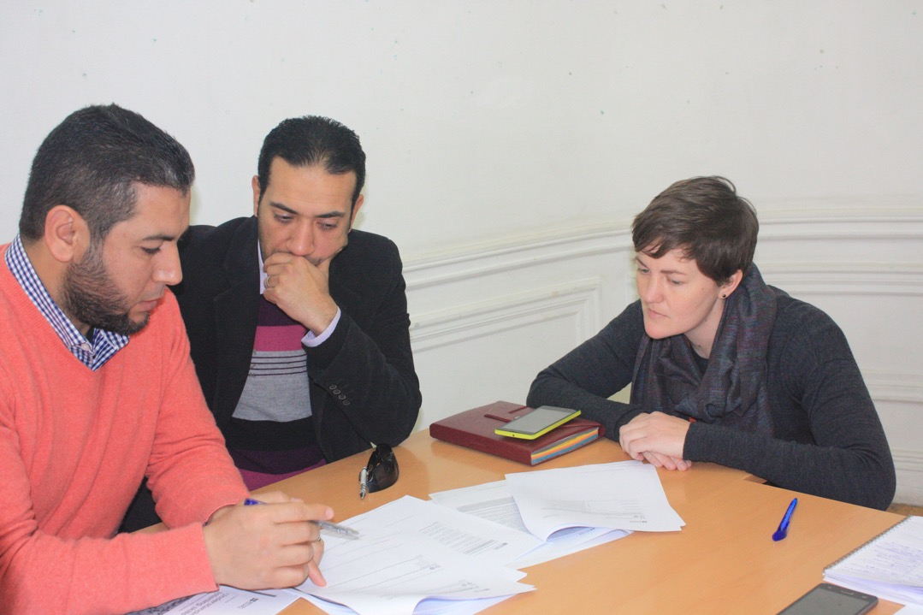
Criticality as ‘the practice of socially situated reflection and evaluation’ - Banegas & Villacañas de Castro (2016) Criticality. ELT J 70 (4), 455-457.
‘Twenty-first century learners require the ability to evaluate multiple sources of information, judge the usefulness and reliability of its content, and make decisions about what to believe’ – Yang & Gamble (2013), Effective and practical critical thinking-enhanced EFL instruction. ELT J 67 (4), 398-412.

Slide 4
‘At present, as teachers, we really do an excellent job of transmitting the content, but we certainly fail to teach how to think, how to understand, how to analyze and how to evaluate’ – Mustafa Z. Altan, (2010), Teaching Global Issues. Modern English Teacher 19 (1), 60-64.

Slide 5
Critical of what?
…or of who?
Course materials
Course participants
Course content/trainer

Slide 6
i. Course Materials

Slide 9
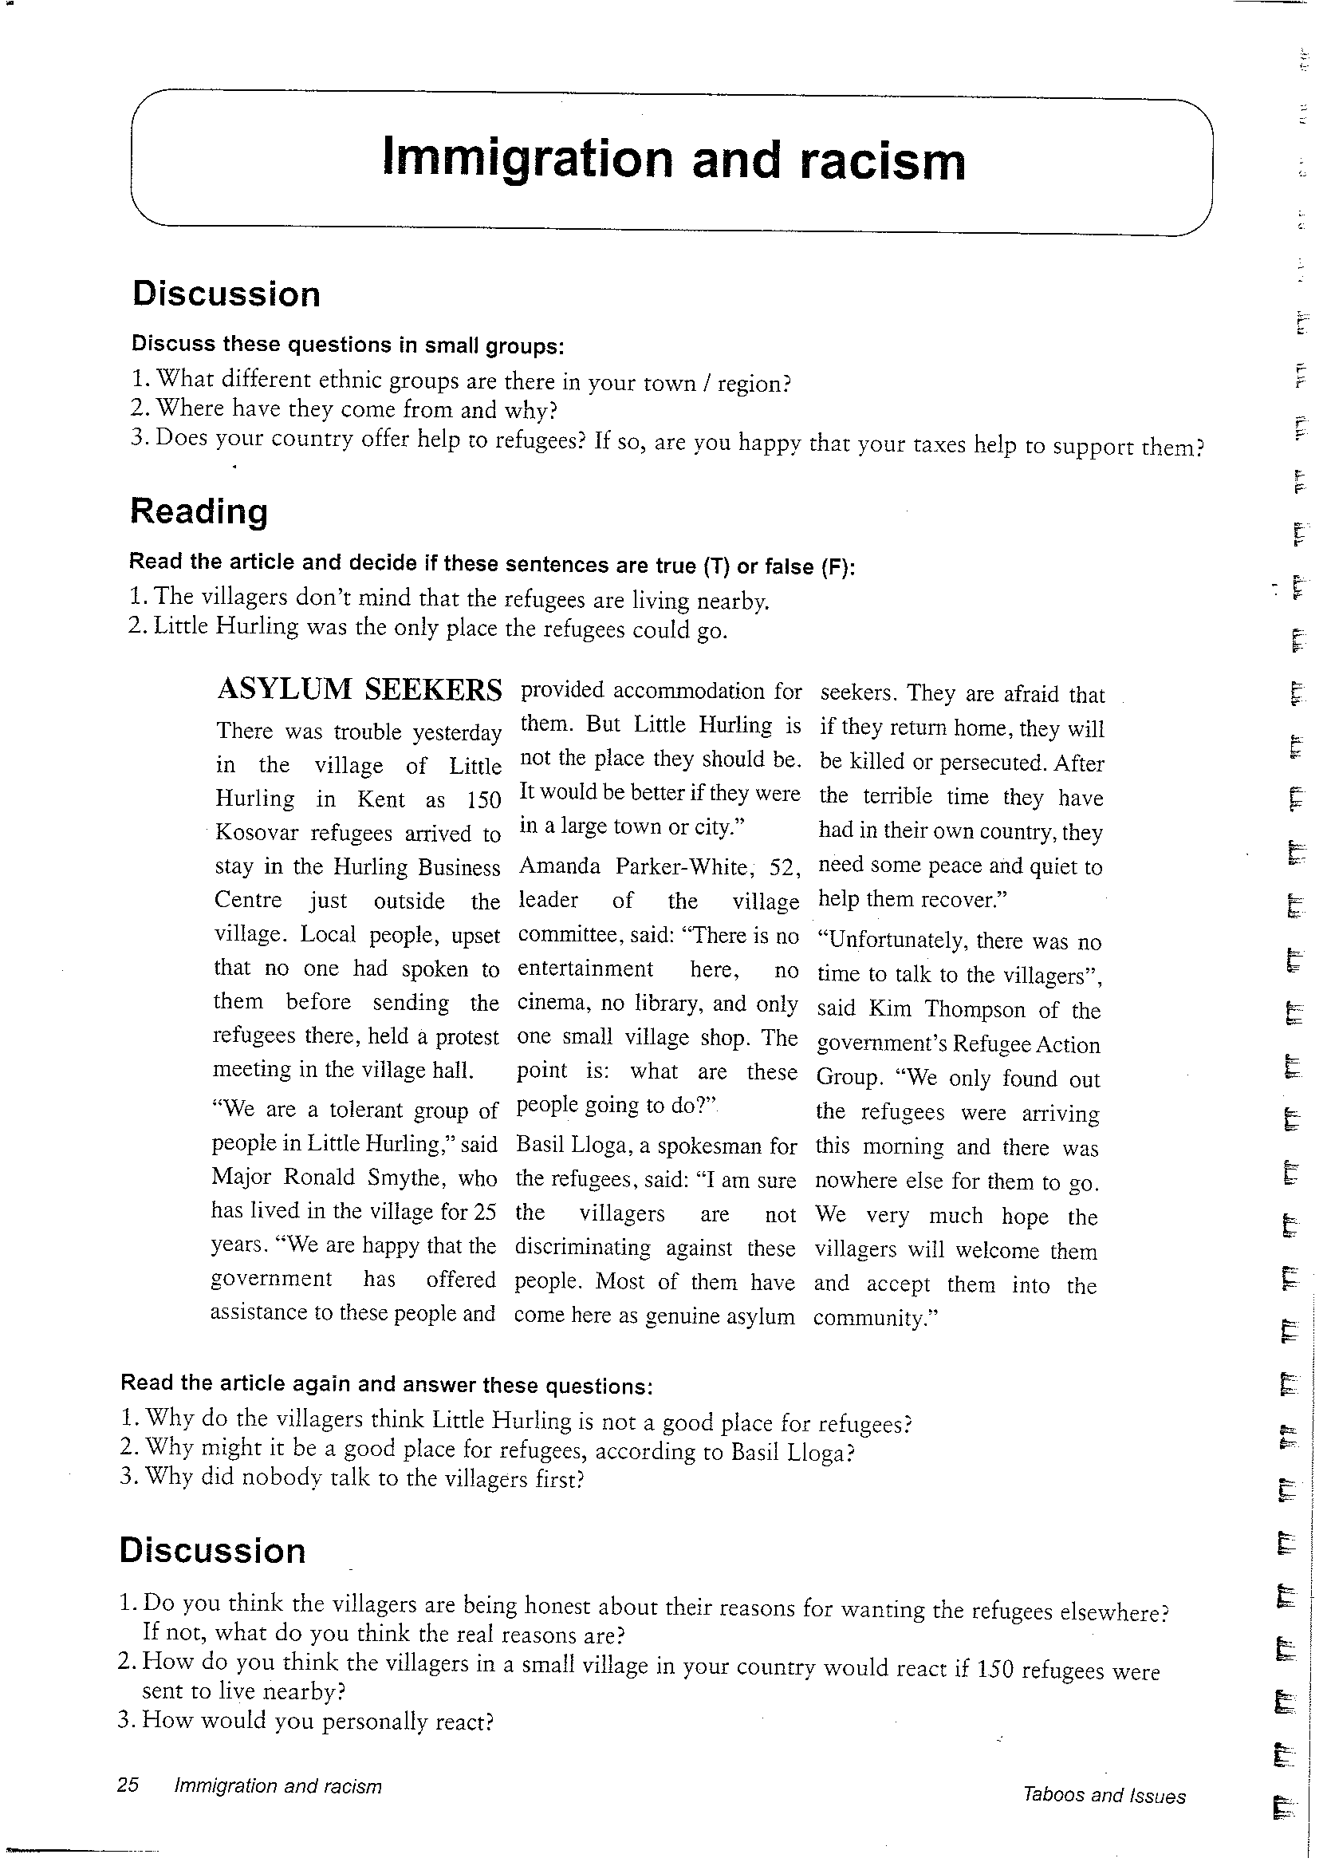
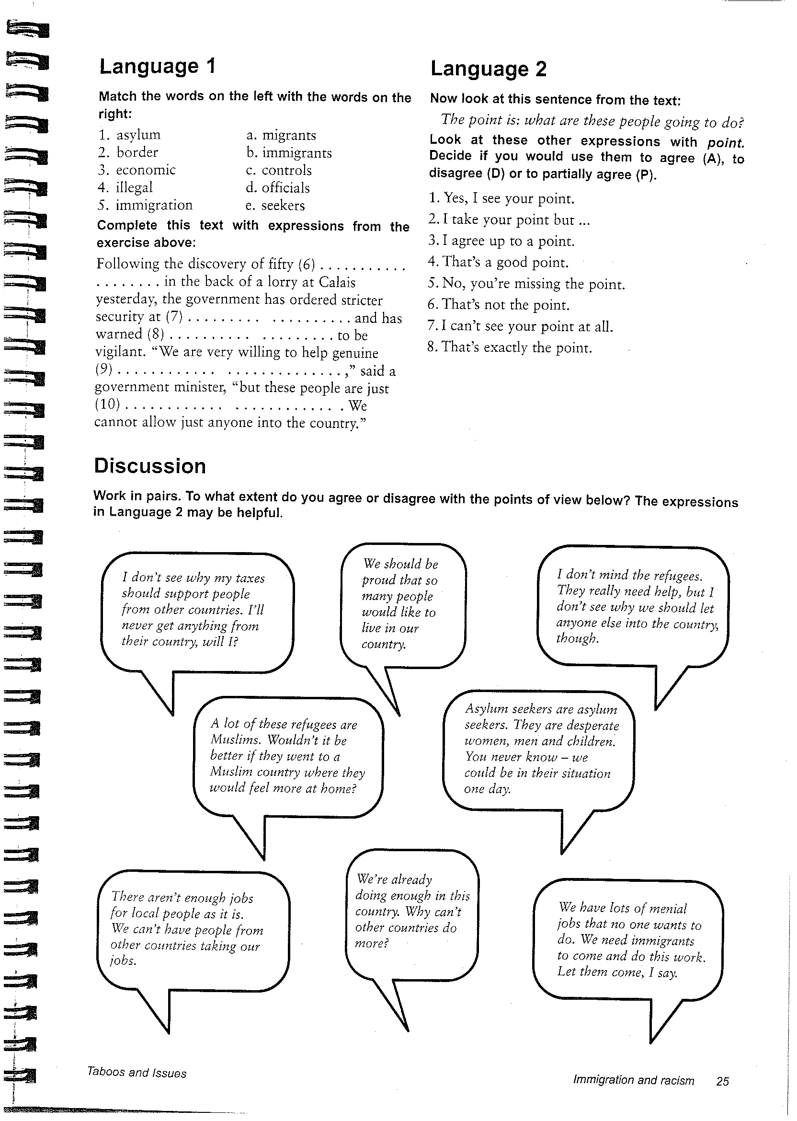

Slide 10
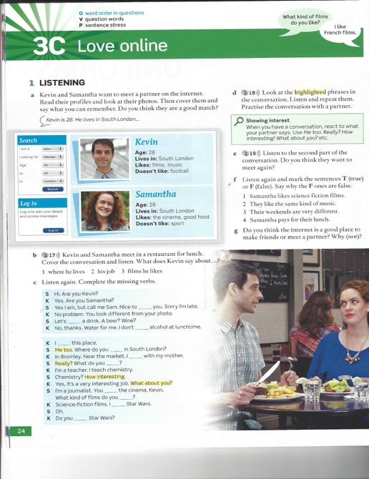
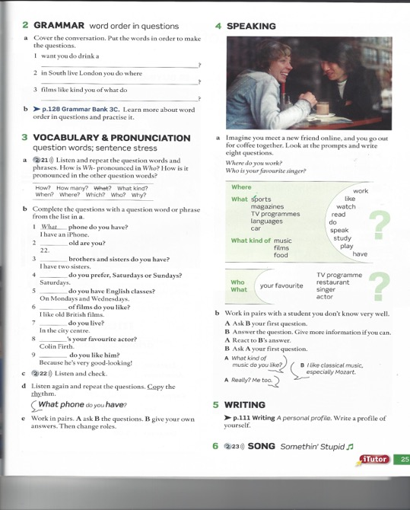

Slide 11
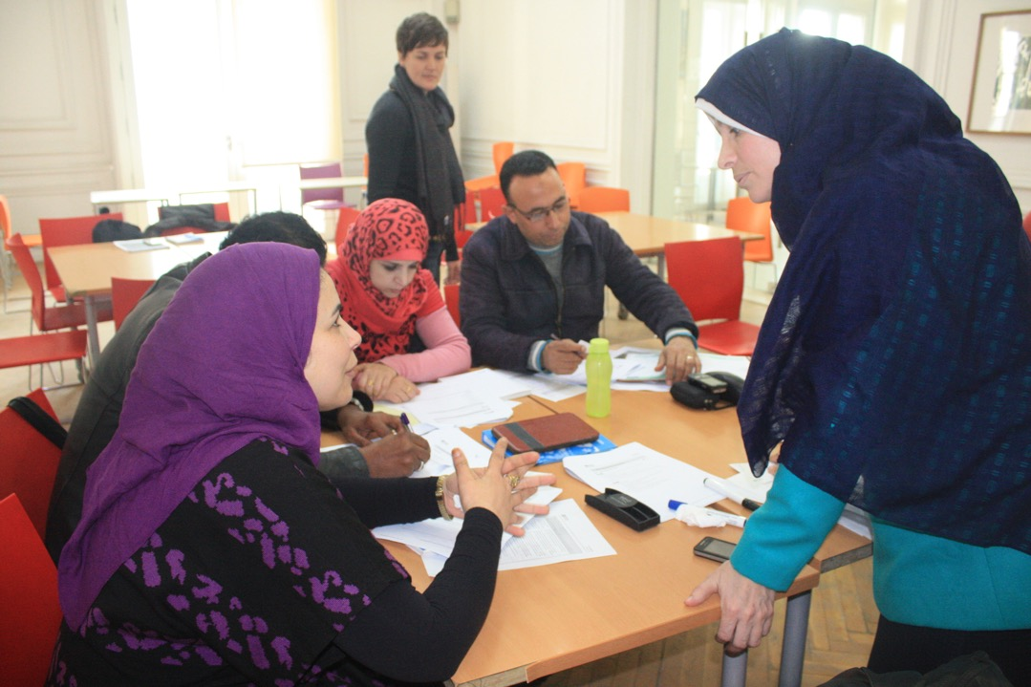
ii. Course participants

Slide 12
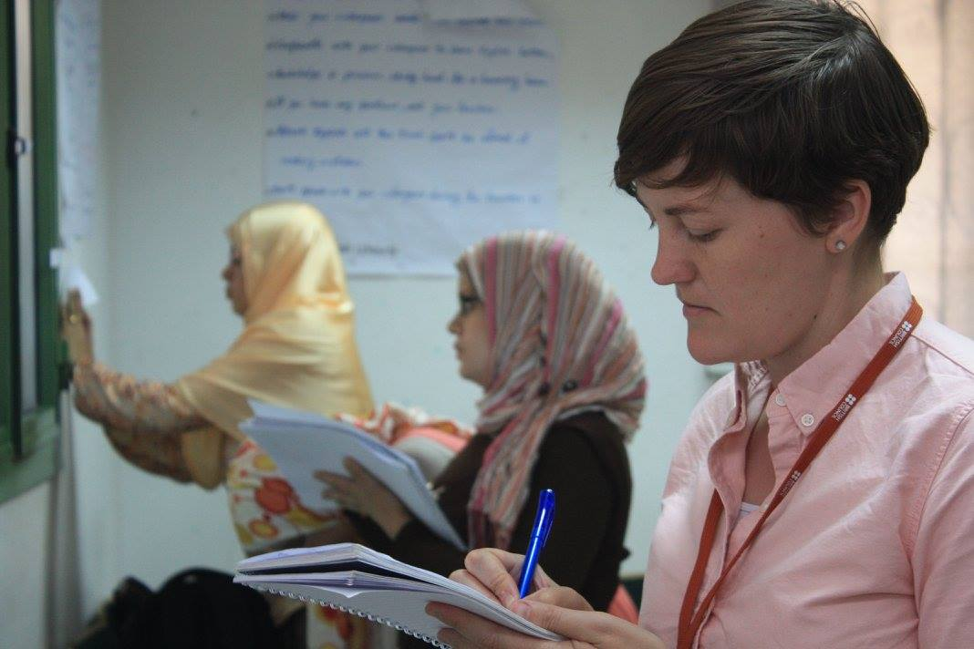
iii. Course content/trainer

Slide 13
I believe…
Reading aloud is not a useful classroom activity.
Teacher talking time should be kept to a minimum.
I should teach L1 culture as well as language.
Activities should be personalised where possible.
There should be a balance of accuracy and fluency in every lesson.
Learners should be tested regularly.
Speaking is more important than writing in class.
I should encourage students to aim for native speaker pronunciation.
The teacher should never use the learners’ L1.
Native speakers make better English teachers.

Slide 14
Thank you!
www.pop-uptrainer.com rose.aylett@gmail.com

